Slide 1
2023-01-09
(This is a ISO8601 formatted date. This is the best format because it sorts well!)

Slide 2
7.3: Traversing ArrayLists with Loops

Slide 3
Traversing ArrayLists
ArrayLists support the same mechanisms you used when traversing Arrays - while, for, for-each - with the following differences
Operation | Array | ArrayList
length/size | Array.length (property) | ArrayList.size() (method)
read | value = array[index]; | value = arrayList.get(index);
write | array[index] = value; | arrayList.set(index, value);

Slide 4
Traversing ArrayLists
Array - for loop
Integer[] array = {1, 2, 3, 4, 5}; for (int idx = 0 ; idx < array.length ; idx++) { int value = array[idx]; System.out.println(value); array[idx] = value + 1; }
ArrayList - for loop
Integer[] array = {1, 2, 3, 4, 5}; ArrayList<Integer> arrayList = new ArrayList<Integer>(Arrays.asList(array)); for (int idx = 0 ; idx < arrayList.size() ; idx++) { int value = arrayList.get(idx); System.out.println(value); arrayList.set(idx, value + 1); }

Slide 5
Traversing ArrayLists
Array & ArrayList - for loop ArrayIndexOutOfBoundsException
This exception will be thrown if you try to access the item at an index less than 0 or greater than the number of items in the Array or ArrayList

Slide 6
Traversing ArrayLists
Array - for-each loop
Integer[] array = {1, 2, 3, 4, 5}; for (Integer value : array) { System.out.println(value); }
ArrayList - for-each loop
Integer[] array = {1, 2, 3, 4, 5}; ArrayList<Integer> arrayList = new ArrayList<Integer>(Arrays.asList(array)); for (Integer value : arrayList) { System.out.println(value); }

Slide 7
Traversing ArrayLists
ArrayList for-each loop ConcurrentModificationException
This exception will be thrown if you try to add or remove items from an ArrayList while traversing that ArrayList with a for-each loop

Slide 8
7.4: ArrayList Algorithms

Slide 9
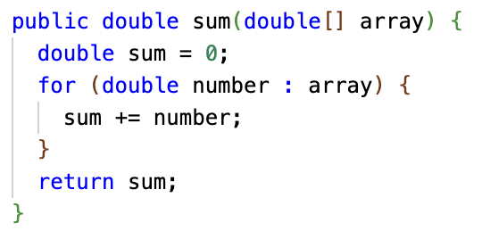
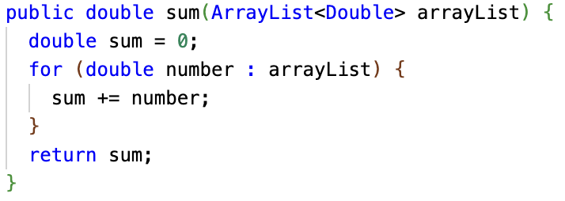
ArrayList Algorithms
A lot of the algorithms we learned for arrays can be applied directly to ArrayList.
Sometimes the code is almost exactly the same!

Slide 10
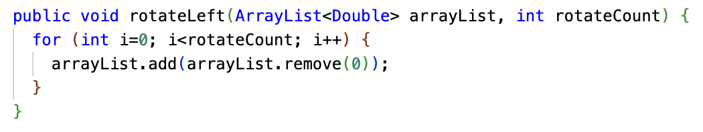
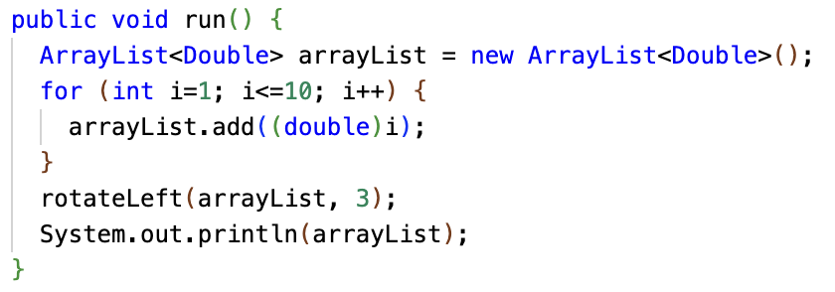
ArrayList Algorithms
Some things are easier with ArrayList because ArrayList has more built-in functionality. Remember rotating an array? Super easy with ArrayList.
But some things are harder... no equivalent to Array literals, for one.

Slide 11
List vs ArrayList
Sometimes you may see code like List<Double> instead of ArrayList<Double>. What's the difference?
ArrayList is part of Java's Collections library. Collections are grouped into kinds: Lists, Maps, Sets, etc. ArrayList is a subclass of List. But there are other kinds of List. For instance, Arrays.asList returns a List, but it's NOT an ArrayList, it's a fixed-size list:
import java.utils.List; import java.utils.Arrays; ... public void run() {
List<Integer> list = Arrays.asList(1, 2, 3, 4, 5, 6);
System.out.println(list);
list.add(7); // <- Blows up with UnsupportedOperationException
}

Slide 12
Array vs ArrayList: How to choose?
When solving a problem, you may need to choose Array or ArrayList. ArrayList has more power, but it's built on arrays, so it adds some overhead.
Array | ArrayList
I know exactly how many "slots" I need up front. I want to use the slots without having to "add" them all first. I want to use Array literals or other features not available on ArrayList. I don't need the extra functionality offered by ArrayList for this use case. I need every last bit of performance. Avoid method call overhead Avoid wrapper type overhead | The number of slots I need is not known up front. The number of slots I need may grow and shrink over time. I need to insert or remove elements or use other methods ArrayList has not available on Arrays. I want to pass this data to some code that expects a Java Collection.

Slide 13
CSAwesome 7.4.2: ClimbingClub
Much of CSAwesome 7.4 is practice FRQs for the AP Exam. These are good to work through!
Let's work through one of them together. Write your own code, then we'll show a solution and discuss.
However, let's do it using this Replit so that you can get the exercise of writing the code in part (c), not just checking the code that they present.
The solutions are in this slide deck but don't peek! Work through it yourself!
Replit: ClimbingClub

Slide 14
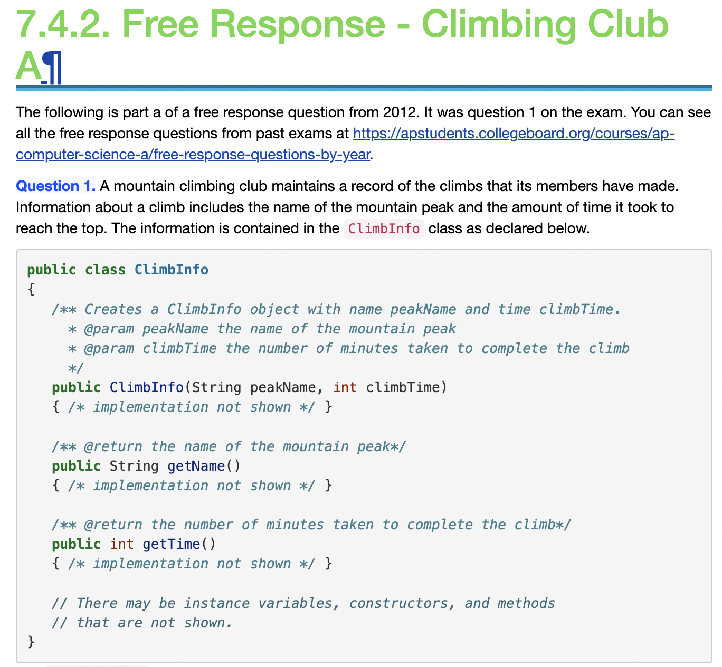

Slide 15
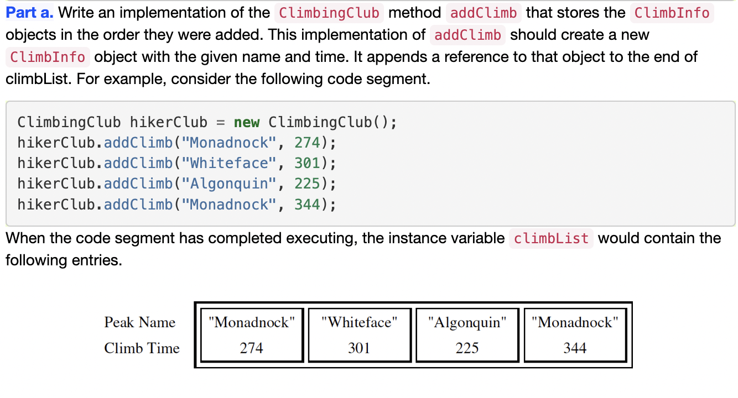

Slide 16
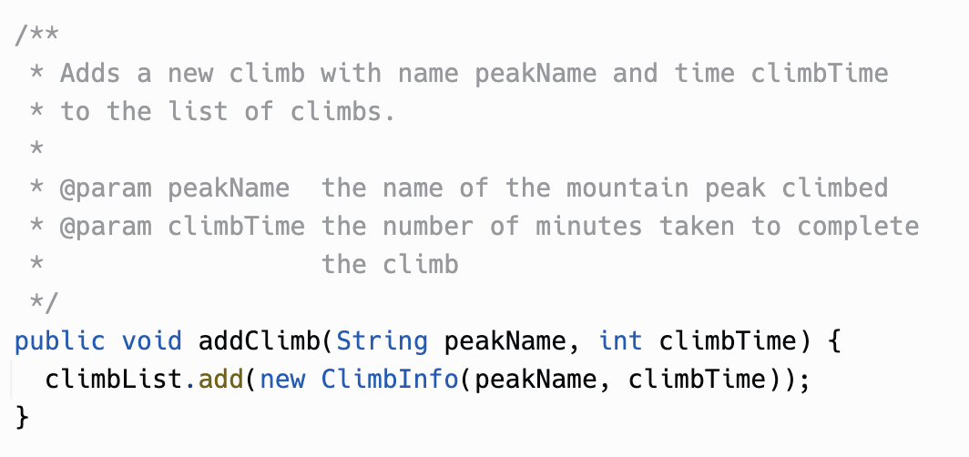
Part (a) solution

Slide 17
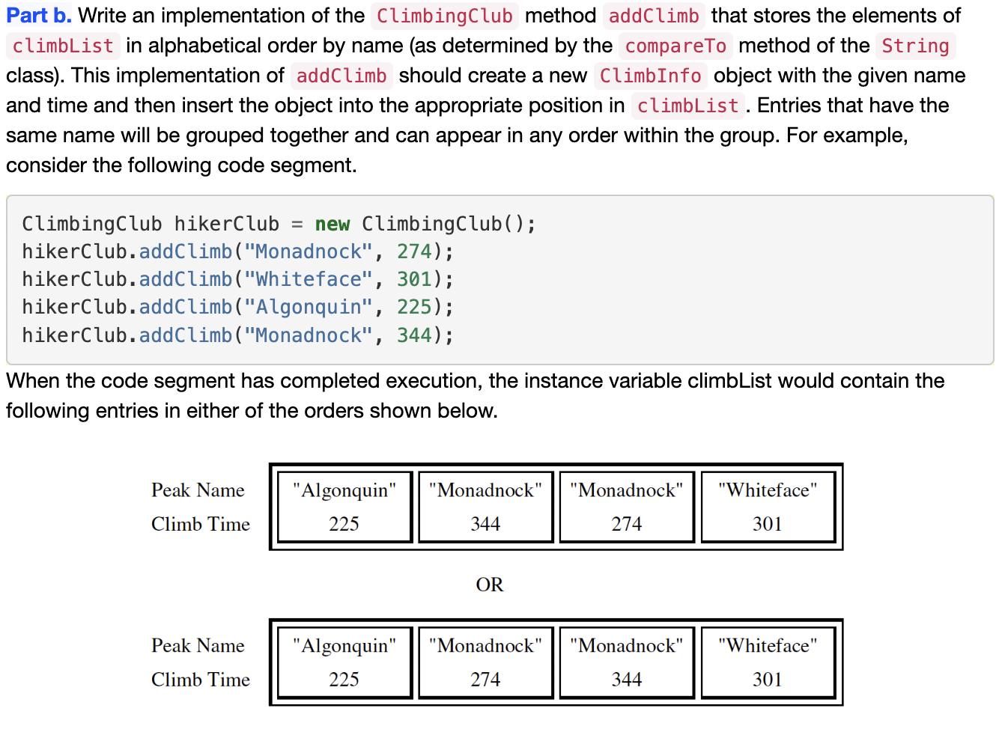

Slide 18
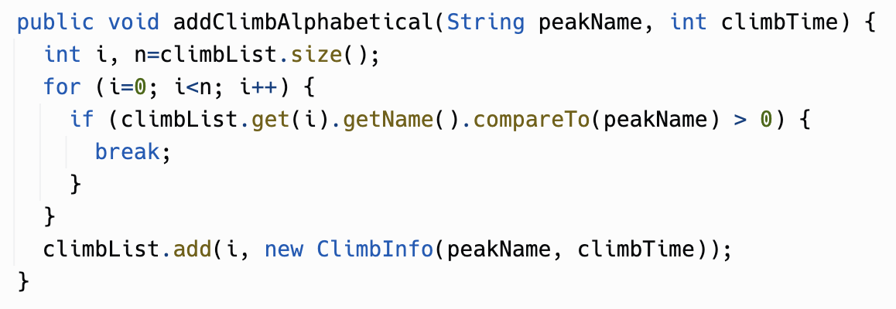
Part (b) solution

Slide 19
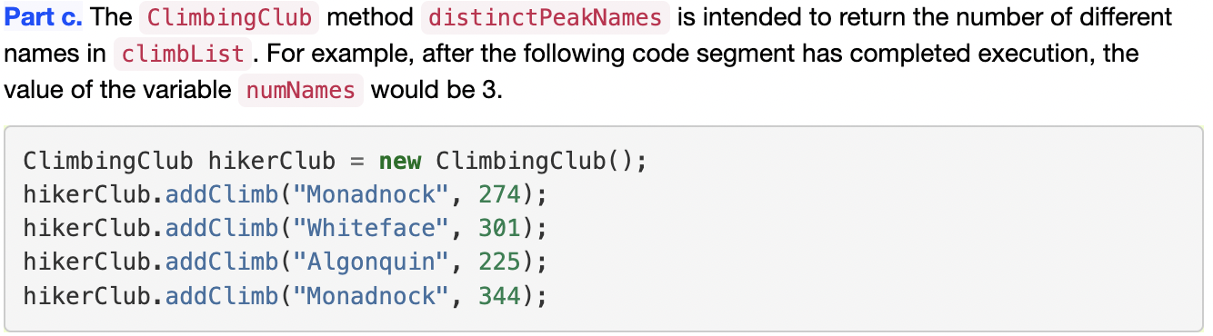
The AP Exam FRQ actually GIVES you a pre-written method for this, and asks you some questions about it. Instead, let's try to write the method. Think about the ArrayList algorithms we learned back in Section 6.4.

Slide 20
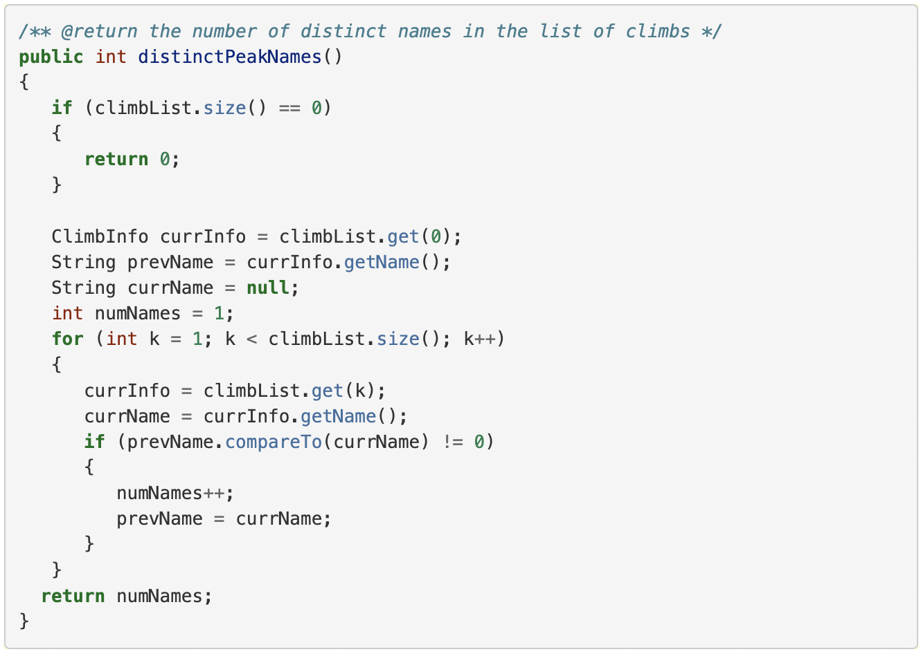
Part (c) solution from the AP exam

Slide 21
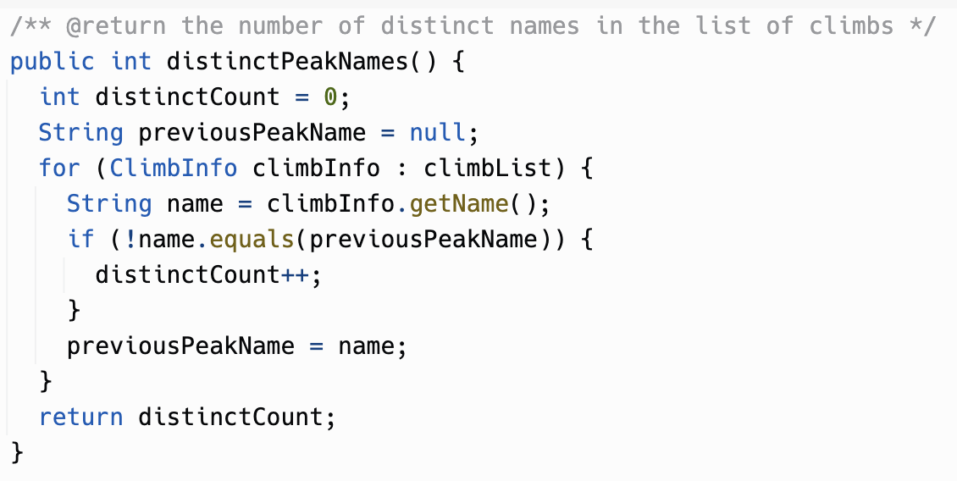
Part (c) solution

Slide 22
Practice on your own
There are several other FRQs in CSAwesome 7.4.
With the remaining time, start working through one of the others.
These FRQs are directly from past AP Exams, so they're good practice, but they're also good applied programming practice in general.

